Slide 1
Finding fastest route
A* LABORATORY EXERCISE
with Robocode
Adam Steciuk
Maciej Kuzma

Slide 2
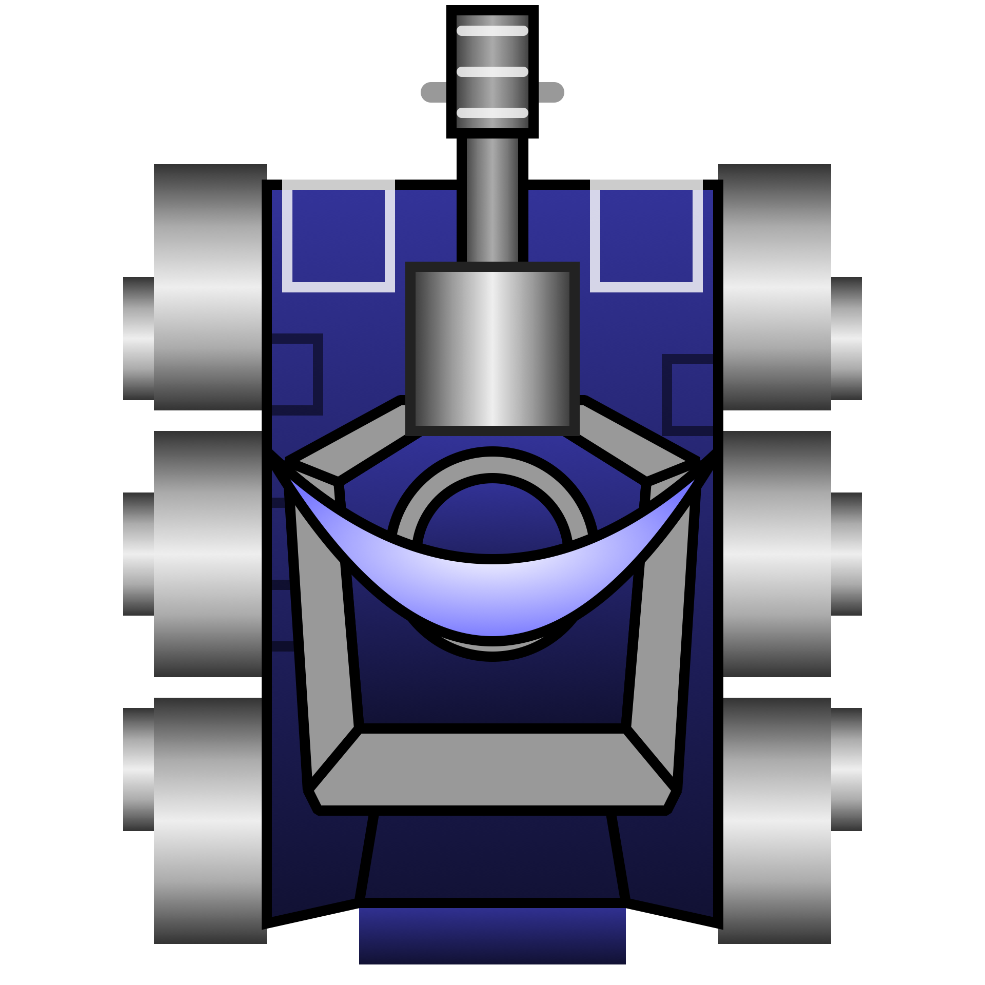
Summary of the problem
Our goal was to develop a robot which is able to find its way in a battlefield full of SittingDuck static robots.
A certain fraction of the tiles contain a SittingDuck robot. The occupied tile of SittingDuck, the initial and goal states for the agent were chosen at random.
Robot is using A* algorithm to find shortest sequence of actions to move from initial state to the goal state

Slide 3
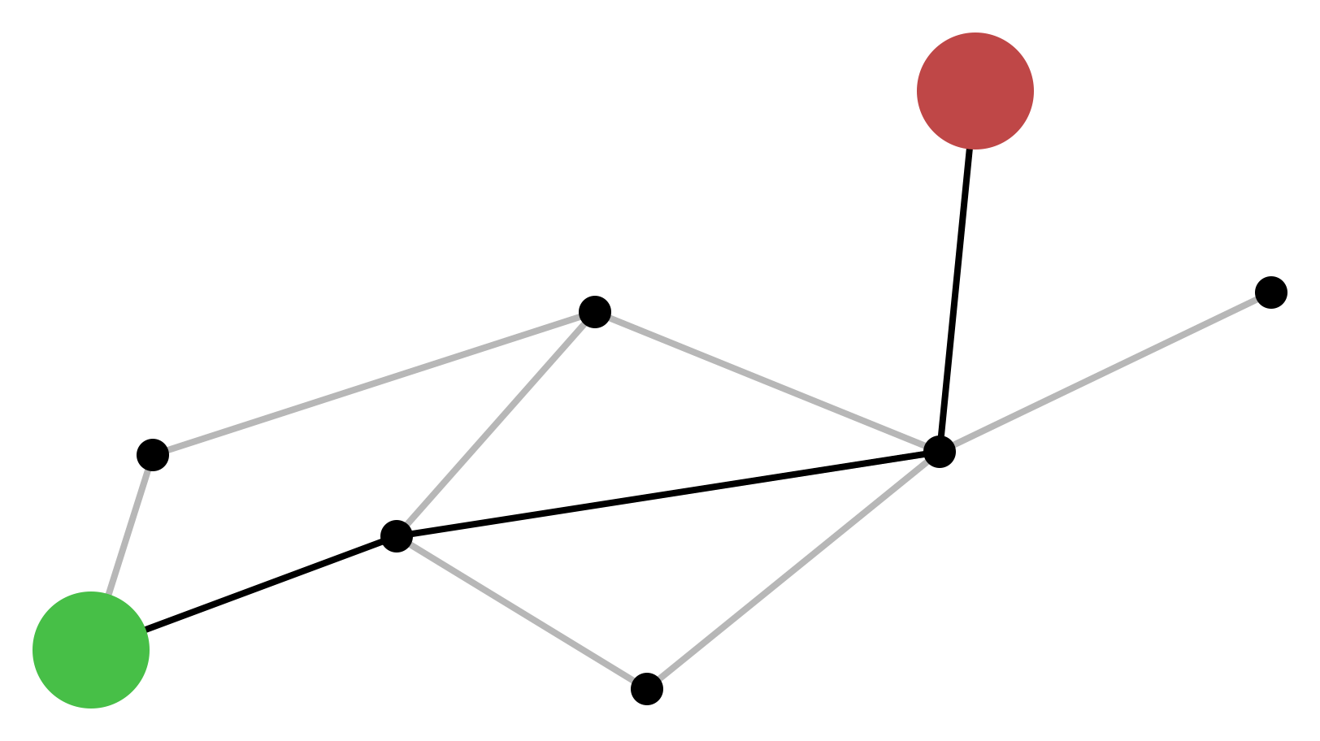
A* algorithm
A* is an informed search algorithm, or a best-first search, meaning that it is formulated in terms of weighted graphs: starting from a specific starting node of a graph, it aims to find a path to the given goal node having the smallest cost. It does this by maintaining a tree of paths originating at the start node and extending those paths one edge at a time until its termination criterion is satisfied.
In solution of our problem the agent must use the A* algorithm

Slide 4

Defining problem
Propose a suitable representation of the states.
A state is a pair of cooridnates (a,b) of current position of the agent.
rows > a >= 0
cols > b >= 0
Describe the search space.
The state space is the set of all pairs with the above mentioned structure. There are rows x cols numer of possible states
Detail the available actions and their costs.
In each itteration we can move to neighbour state by incrementing or decrementing a or b by one. Cost of each action is the same and one
Provide the goal test.
Goal test is to test wheather the agent coordinates are the same as those of the end state
Is the problem better suited for tree search or for graph search?
It is always possible to go back to a previously visited state, so we need graph search for this problem.
How many goal states are there?
There is only one goal state and it’s the end point
Is it possible to provide an admissible/consistent heuristic for the problem?
A consistent heuristic would be the Manhattan distance from the robot to the end state becouse we cannot decreese distance to the goal state by more than one in a step

Slide 5
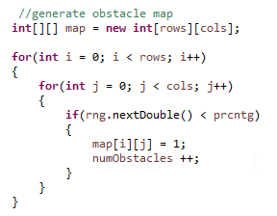
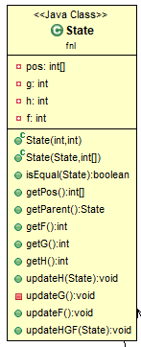
Design process
Obstacle map with specified numer of sitting ducks is generated
- Obstacle map: 2D array (rows x cols) with 0 if the corresponding place is free and 1 if the place is occupied by obstacle
Start point and and point is randomly choosen from free spaces in obstacle map
- Each state is implemented as an object of class State

Slide 6
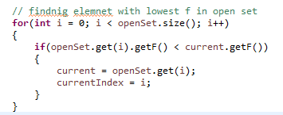
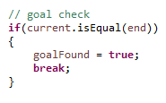
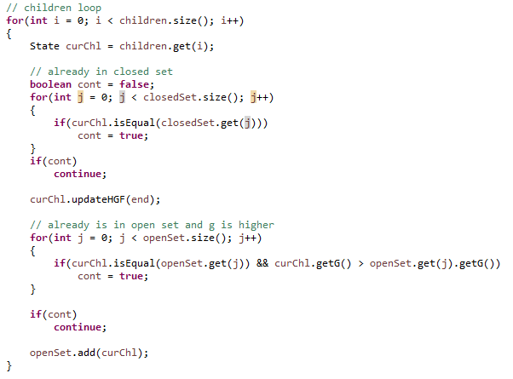
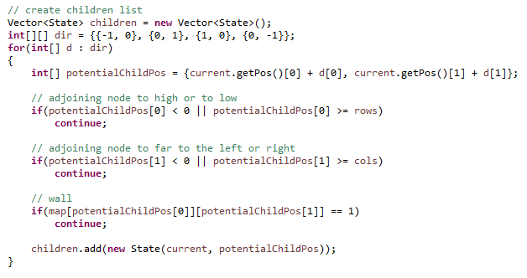
A* algorithm proposed in lectures is then used to find the best path. It ends when we reach the goal state or when the open set is empty and we haven’t found the goal state
When the solution is found. The path is reconstructed recursively (State.getParrent())
In case there is no solution found – there is a mesage displayed that given problem has no solution
Most important elements of the algorithm:

Slide 7
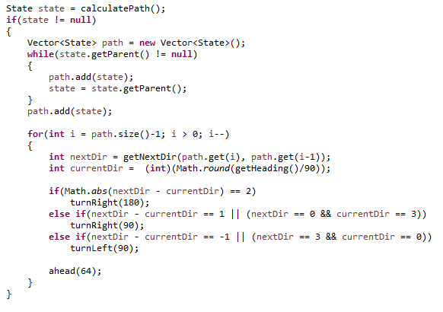
Robot than recreates reconstructed path
It checks if the state to which it has to move is in front of him, to the left, to the right or behind him and turns in the given dirrection and moves 64 pixels to the front

Slide 8
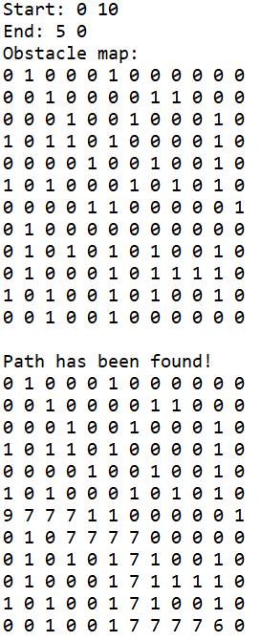
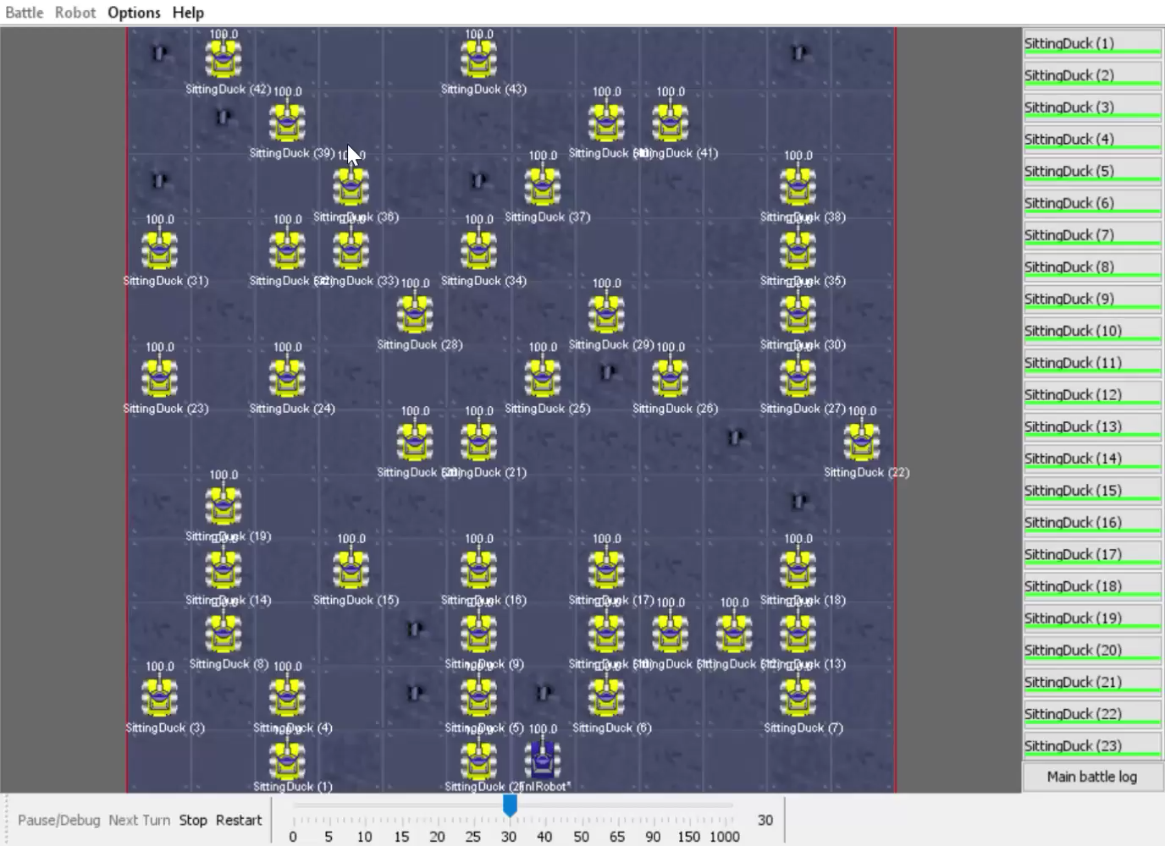
In the video we can see robot placed in starting position (marked with green circle) moving to the ending position (red circle).
Parameters used in example:
Seed = 1
Number of columns = 12
Number of rows = 12
Percentage of SittingDucks = 30%

Slide 9
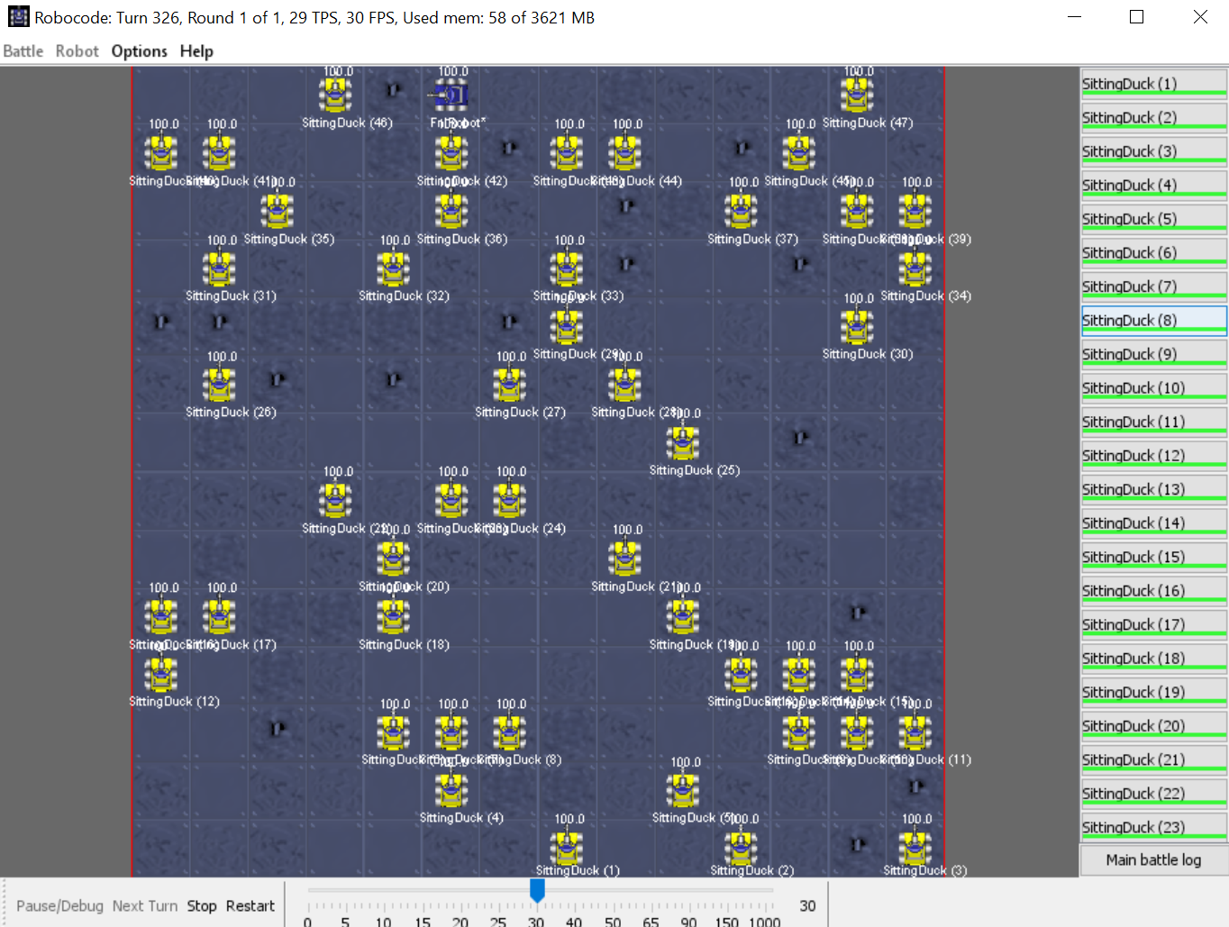
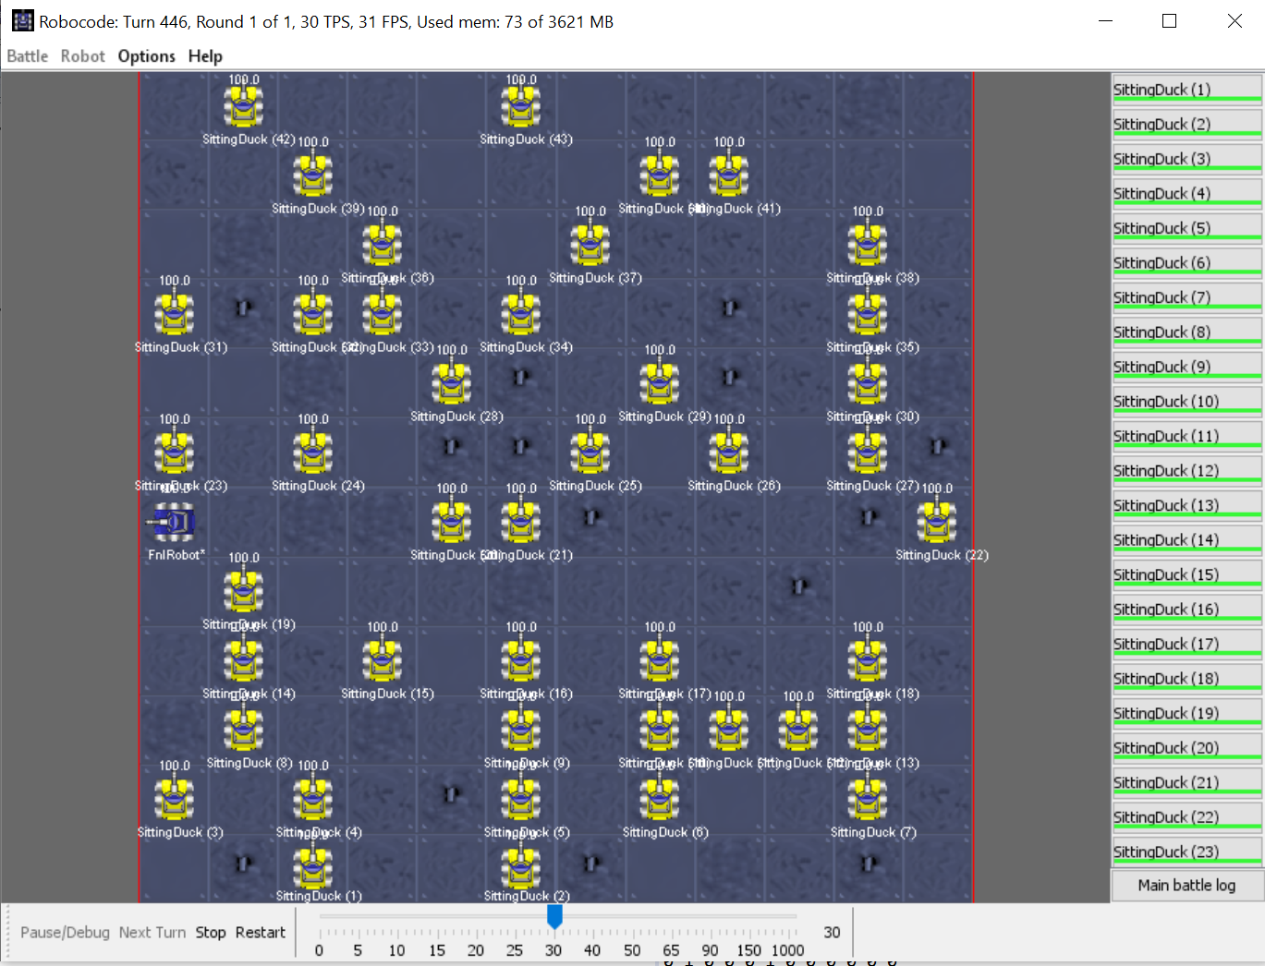
Screenshots of running aplication
For two different set of parameters
Pisał żeby dać screenshoty ale jak są filmiki to chyba nie ma sensu

Slide 10
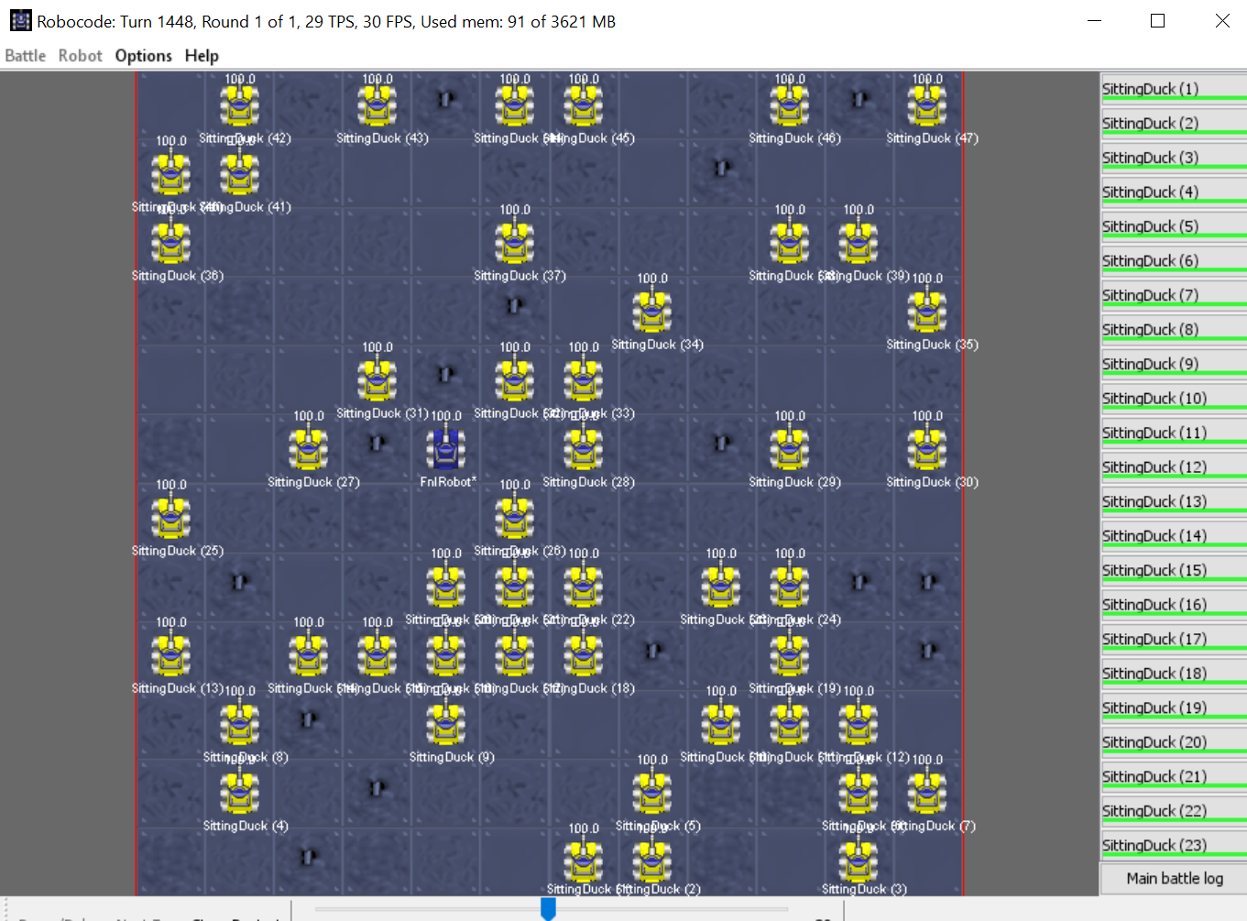
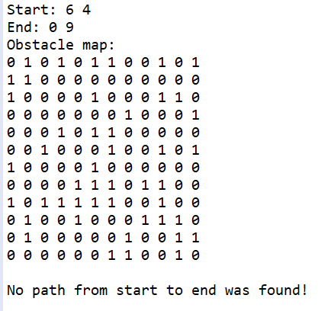
Case with no solution for the problem

Slide 11
Video of running application with commentary that shows all the different cases:
https://www.youtube.com/watch?v=QiYQPbNKX4o

Slide 12
What was the biggest challenge of the project?
Definietely the hardest part of it was forcing robocode and eclipse to cooperate and work properly. I have done things that were shown in the video on campus virtual three times on three different computers and only after third time I was able to run the simulation. I spent at least 3 full days trying to solve problems I was getting
What have I learned while doing the project?
How to interprete given problem
How to formaly describe it
How to choose the best solution
How to check if the implementation of a solution is correct
How to debug in eclipse
How to search Stack Overflow for hardly existant pieces of infomration about issues with robocode
I was fairly familiar with java beforhand so the implementation itself was not a big issue for me.

